Slide 1



USING YOUR CRO EXPERIENCE FOR TRUE ORGANISATIONAL TRANSFORMATION

Slide 2


Hi!
I’m Manuel
I OPTIMISATION
7+ Years CRO strategy + consulting
Founder, Effective Experiments
All-in-one platform for CRO workflow
management, collaboration & documentation
Podcast Host, Conversionations

Slide 3
WHAT IS THE JOB OF A CRO TEAM?

Slide 4
Run A/B TESTS
RESEARCH CUSTOMER BEHAVIOUR
ANALYSE RESULTS
WRITE UP REPORTS

Slide 5
CONVERSION OPTIMIZATION IS BUSINESS TRANSFORMATION

Slide 6

CONVERSION OPTIMIZATION IS BUSINESS TRANSFORMATION

Slide 7
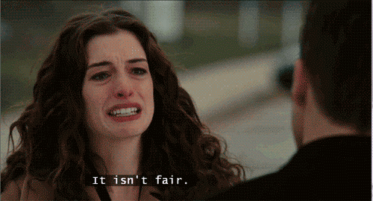
I NOTICED SOME RECURRING SITUATIONS
“HOW CAN I CONVINCE MY BOSS ABOUT THE ROI OF THE WORK I AM DOING”
“HOW CAN I GET BUY IN FROM MY MANAGEMENT/OTHER DEPARTMENTS”
“I’M THE ONLY ONE TALKING ABOUT EXPERIMENTATION BUT NO ONE SEEMS TO CARE”
“I CAN’T GET DEV RESOURCES”

Slide 8
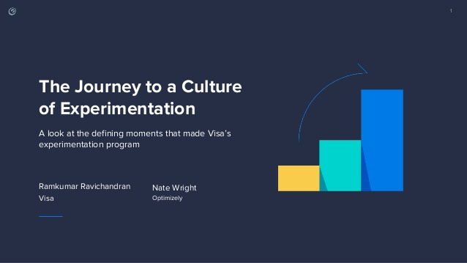

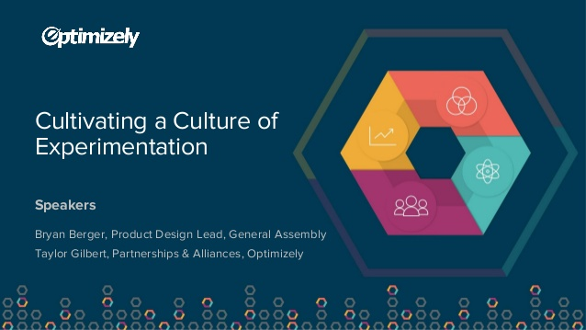
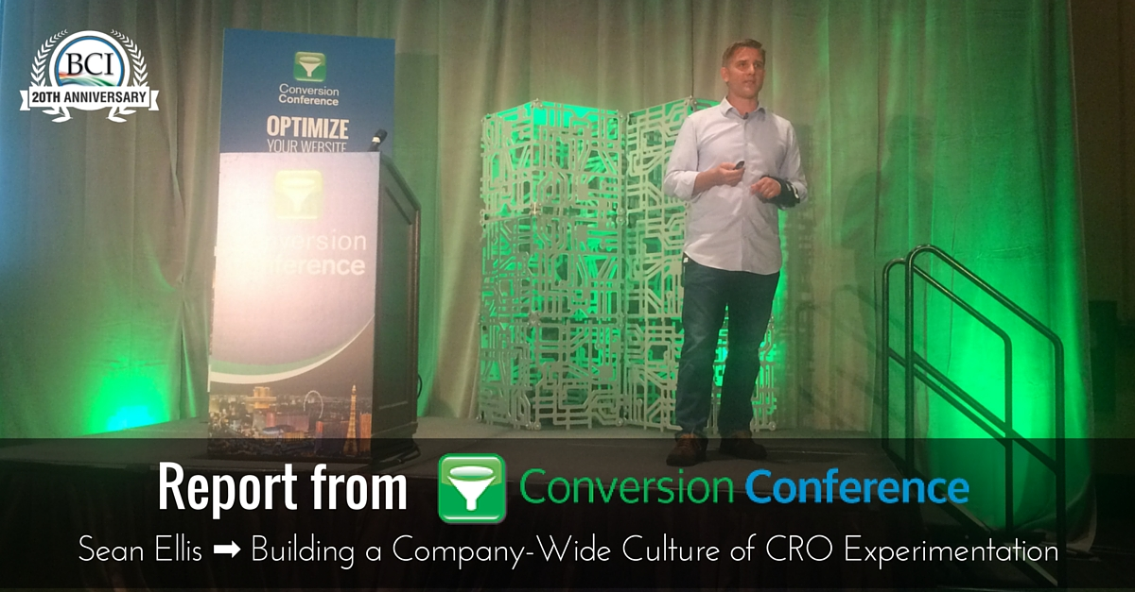
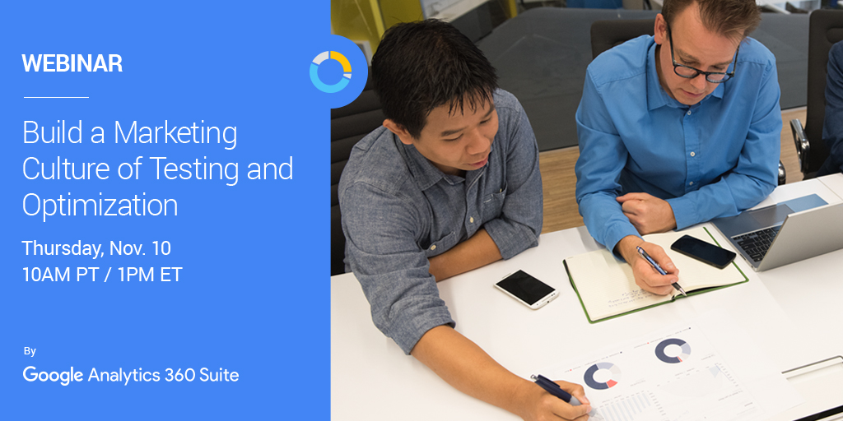
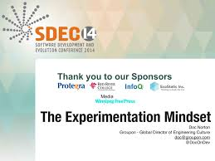

Slide 9
What does success look like?

Slide 10
RuNNING
20 experiments a year ?
50 Experiments a YEAR?
500 experiments a year?

Slide 11
EXPERIMENTATION IS SEEN AS A “BUSINESS AS USUAL” ACTIVITY and is done by all parts of the organisation

Slide 12

OPTIMIZERS ARE VALUED AS ADVISORS & LEADERS. NOT A SMALL PART IN A MARKETING MACHINE

Slide 13

MORE RESOURCE & SUPPORT FROM ALL PARTS OF THE ORGANISATION

Slide 14
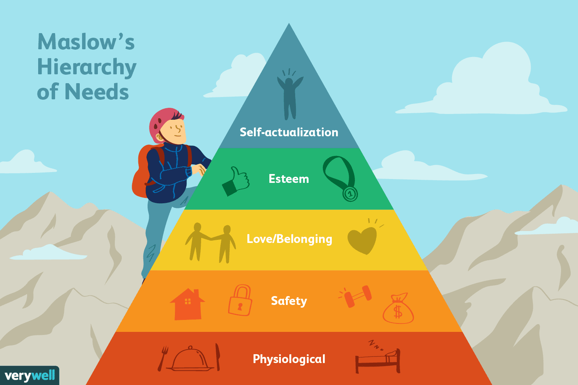
WHAT A CRO WANTS
CULTURE OF EXPERIMENTATION……YAY!!!
REALITY
RELEGATED TO BEING A SILO IN THE ORG
NO TESTING CULTURE
THEY’RE A COST CENTER IN THE ORG
THEY’RE EXPENDABLE

Slide 15
WHAT A CRO WANTS
CULTURE OF EXPERIMENTATION……YAY!!!
Culture of Exp
What is this gap?
REALITY
C.A.V.E
The Framework
RELEGATED TO BEING A SILO IN THE ORG
NO TESTING CULTURE
THEY’RE A COST CENTER IN THE ORG
THEY’RE EXPENDABLE
FOUNDATIONS - SKILLS
ORGANISATIONAL READINESS

Slide 16
THE FRAMEWORK

Slide 17
C
A
V
E

Slide 18
COLLABORATE
A
V
E

Slide 19
BUT..
We send out newsletters
We SEND OUR RESULTS IN EMAILS
WE ASK PEOPLE FOR THEIR iDEAS
We GIVE OUT PRESENTATIONS

Slide 20
THEY SEEM ENTHUSIASTIC…….BUT….

Slide 21


Slide 22
WIIFM
What’s In It For Me?
EVERYONE HAS
THEIR OWN KPIS
THEIR OWN AGENDA
THEIR OWN GOALS

Slide 23


Slide 24
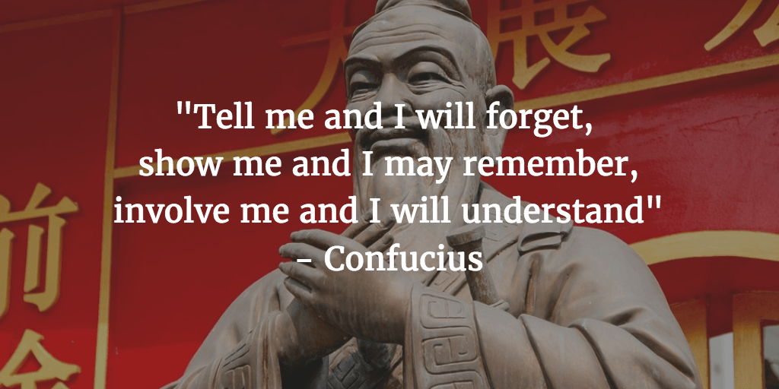

Slide 25
MAKE THEM PART OF YOUR WORLD
ENGAGE & EDUCATE IN A PRACTICAL SETTING

Slide 26
COLLABORATE
ACCOUNTABILITY
V
E

Slide 27
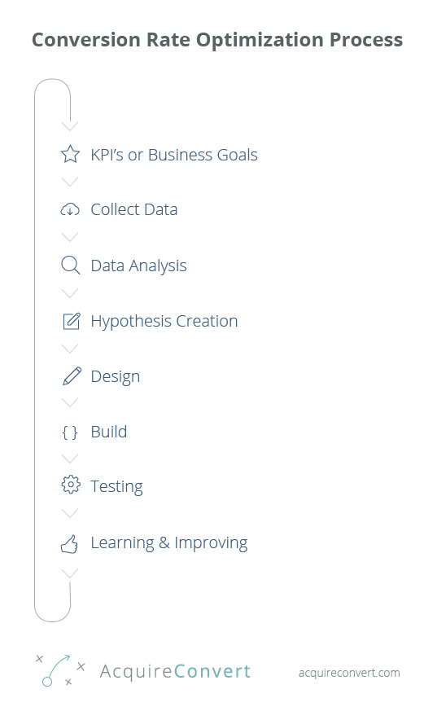


Slide 28
DO YOU HAVE A PROCESS?
SOMETHING THAT IS REPEATABLE & SCALABLE

Slide 29
SYSTEMS SET YOU FREE
DOCUMENTING YOUR WORK MAY SEEM SLOW BUT PAYS DIVIDENDS

Slide 32
THE PARADOX OF GROWTH
AS YOU SCALE UP, THE INEFFICIENT SYSTEMS WILL SLOW YOU DOWN

Slide 33
GOVERNANCE
SYSTEMS & PEOPLE THAT ENSURE EVERYONE IS ACCOUNTABLE

Slide 34
TEAMS WITH NO GOVERNANCE
EVERYONE DOES WHAT THEY FEEL IS RIGHT
BUT IN DIFFERENT WAYS WITH NO STANDARDISED STRUCTURE

Slide 35
NORMALIZATION OF DEVIANCE
PEOPLE BECOME SO ACCUSTOMED TO DEVIANT BEHAVIOUR THAT
IT IS CONSIDERED NORMAL

Slide 36
COLLABORATE
ACCOUNTABILITY
V
EFFICIENCY

Slide 37


Slide 38


Slide 39
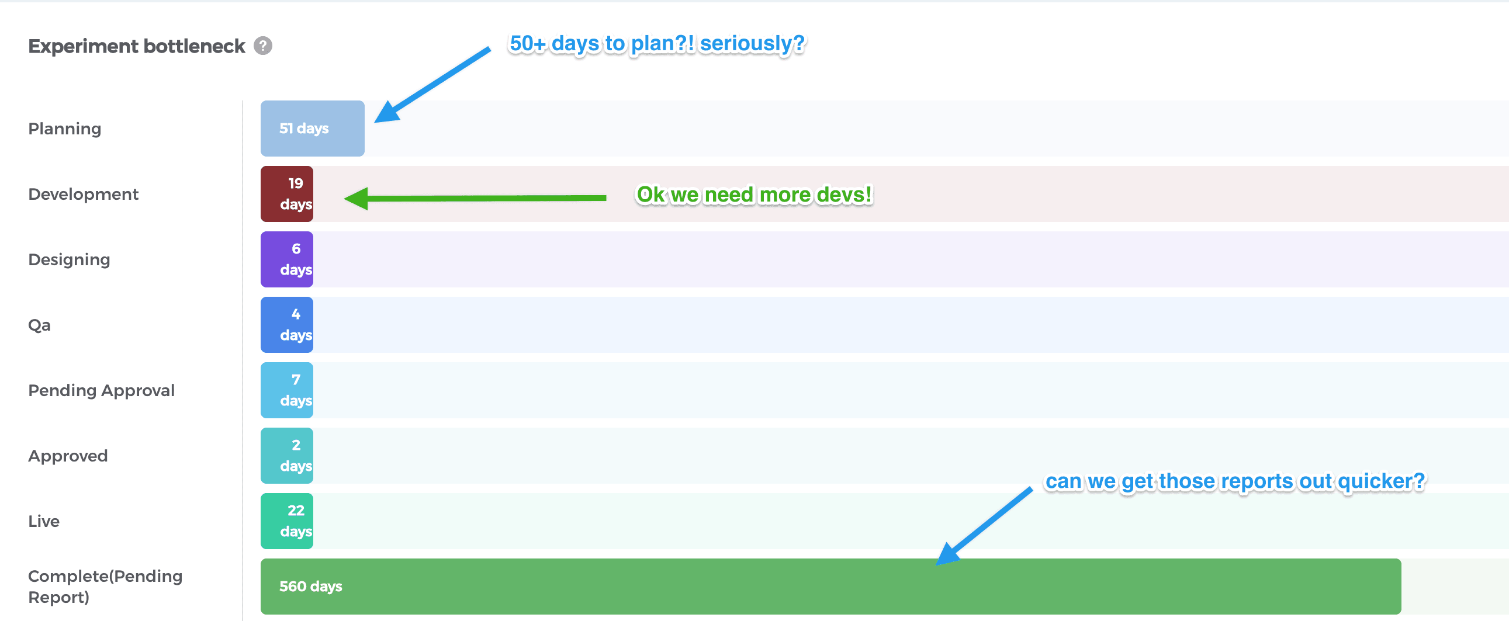

Slide 40
COLLABORATE
ACCOUNTABILITY
VIS-ABILITY
EFFICIENCY

Slide 41
VIS-ABLE
VISIBLE & ABLE TO SELF-SERVE
BOTH ARE NECESSARY
VISIBILITY WITHOUT ABILITY GETS IGNORED
ABILITY WITHOUT VISIBILITY REQUIRES EFFORT
ABILITY & VISIBILITY STILL REQUIRES CONTEXT*

Slide 42


Slide 43
DEMOCRATISING THE DATA
ALLOWING YOUR ORGANISATION TO SELF SERVE

Slide 45
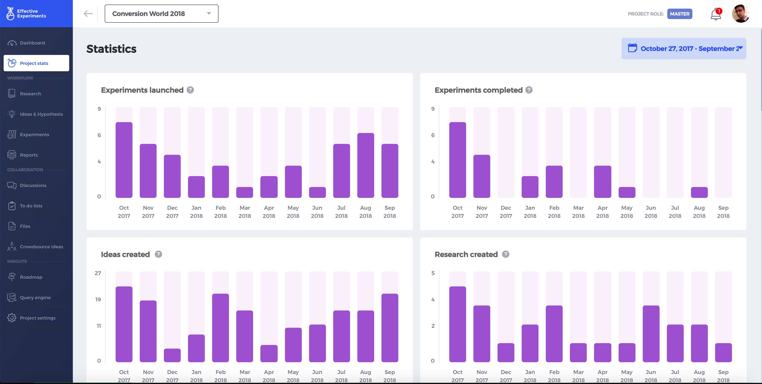
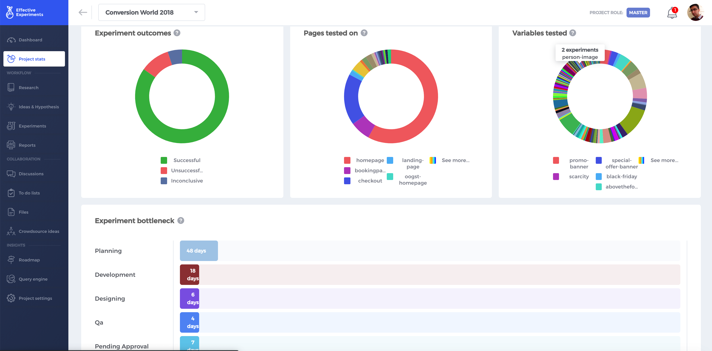

Slide 46
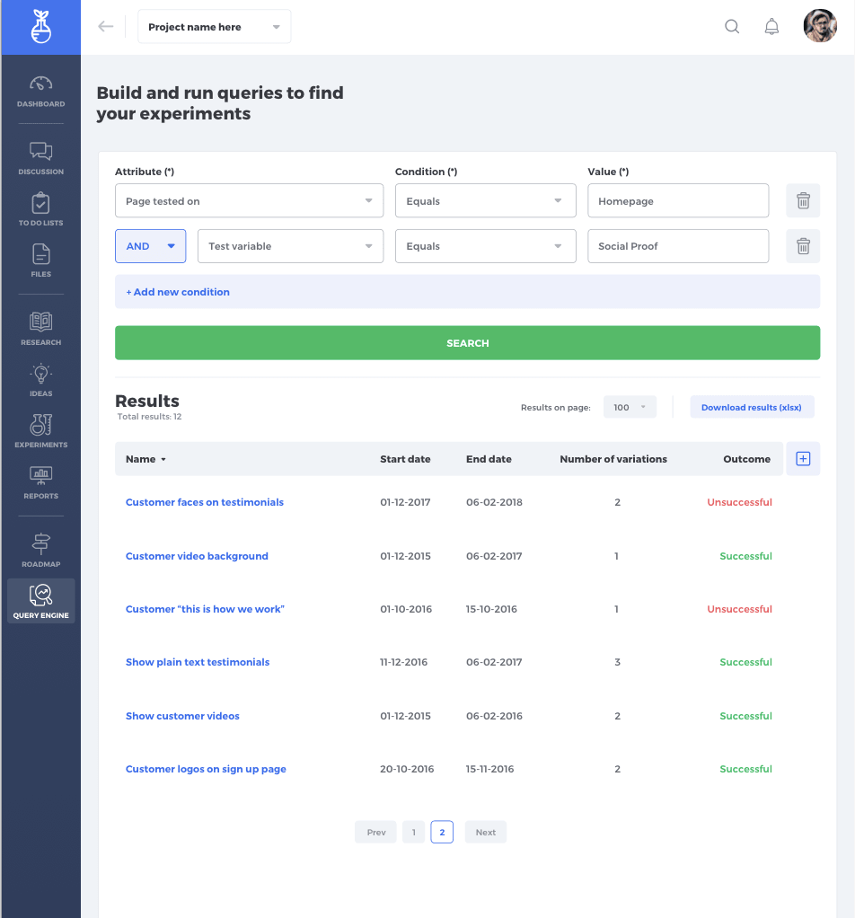

Slide 47
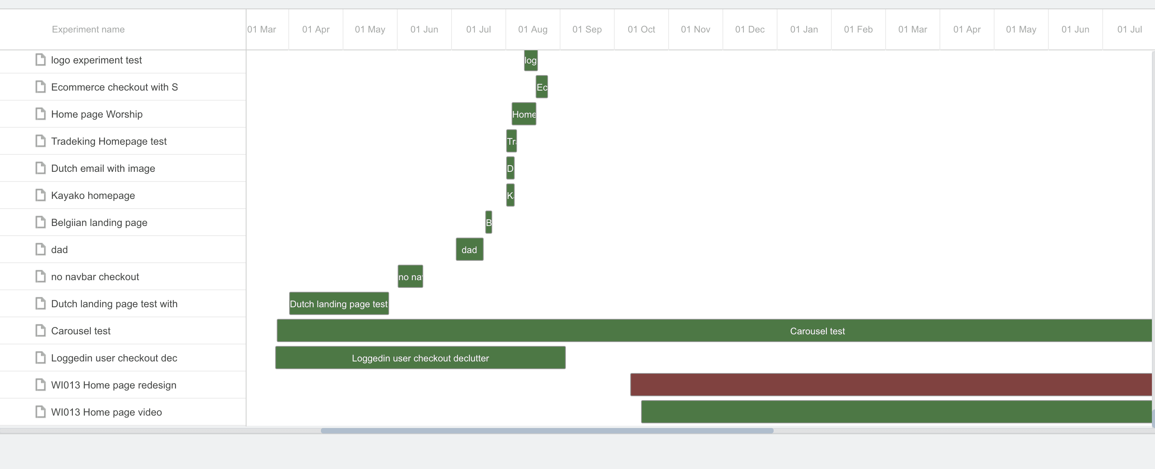

Slide 48
WHAT A CRO WANTS
CULTURE OF EXPERIMENTATION……YAY!!!
Culture of Exp
What is this gap?
REALITY
C.A.V.E
The Framework
RELEGATED TO BEING A SILO IN THE ORG
NO TESTING CULTURE
THEY’RE A COST CENTER IN THE ORG
THEY’RE EXPENDABLE
FOUNDATIONS - SKILLS
ORGANISATIONAL READINESS

Slide 49
STATUS QUO
BE VERY AFRAID FOR ITS PULL IS STRONG

Slide 50
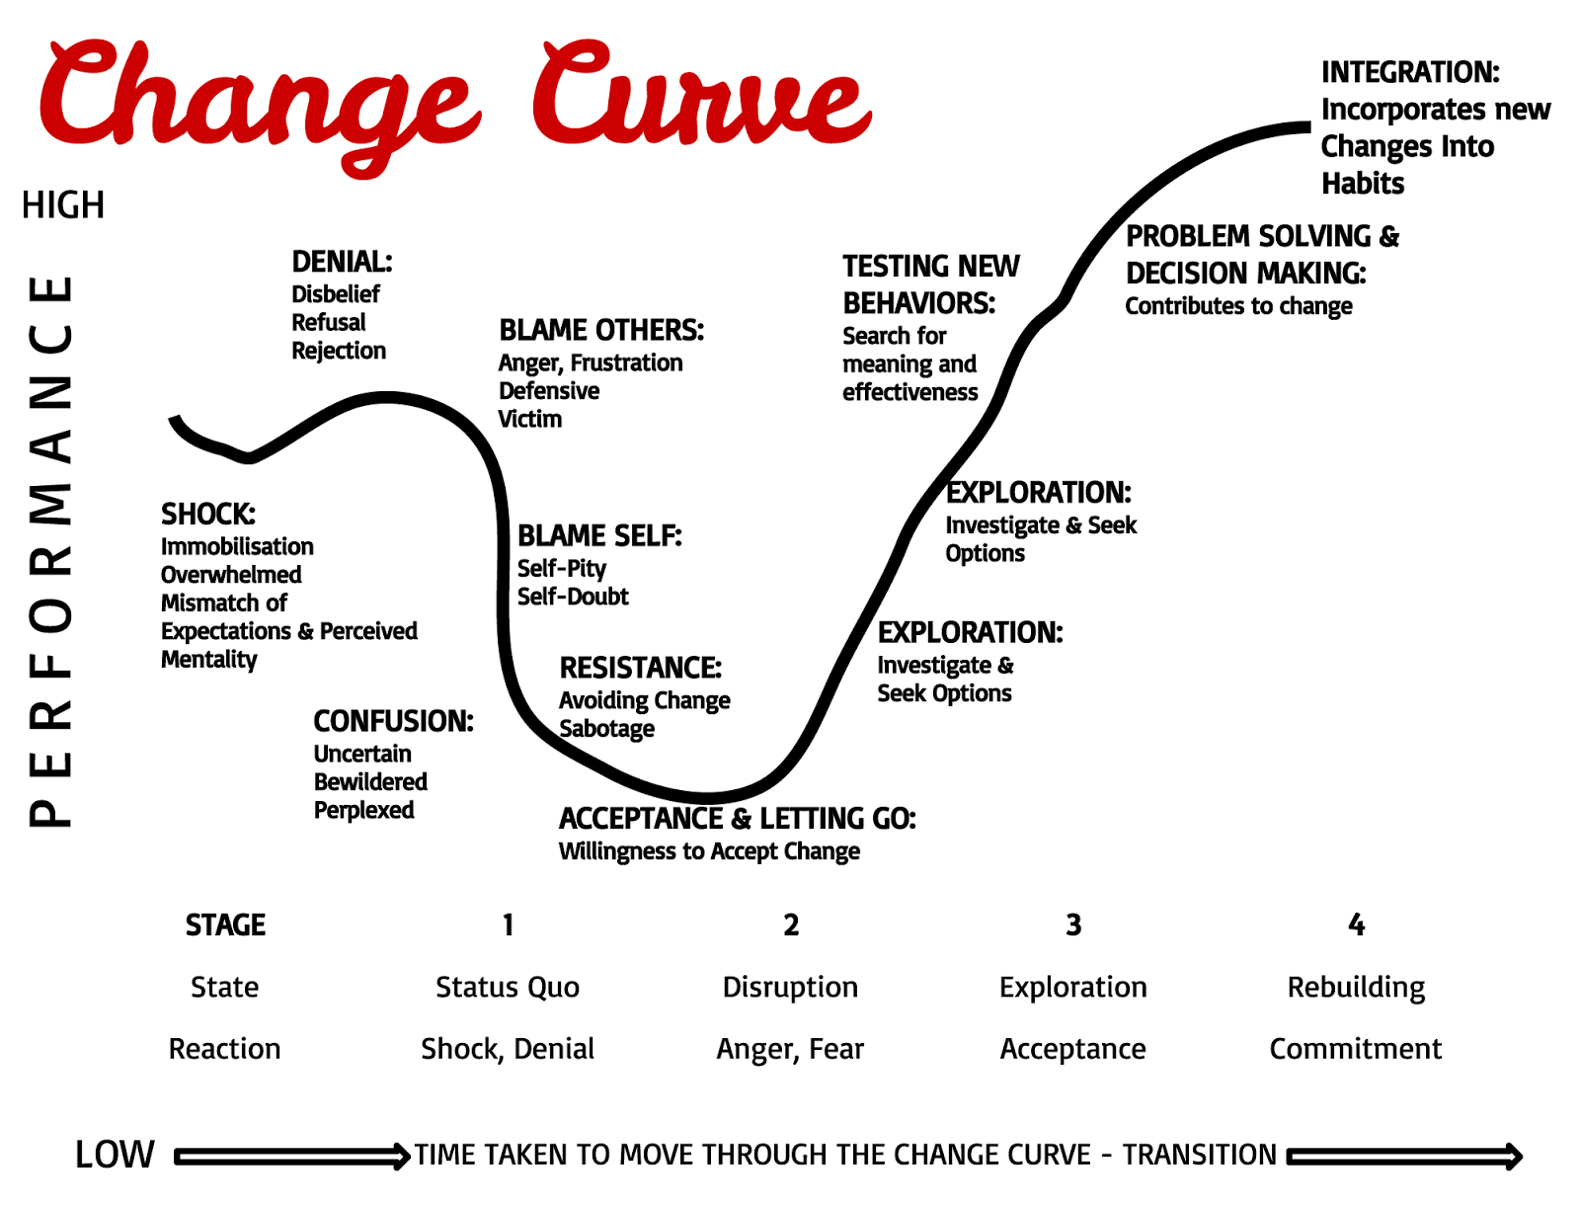
The Kübler-Ross
Change Curve

Slide 51

It starts with the willingness to leave behind the
STATUS QUO

Slide 52
YOU’re ALREADY DOING
RESEARCH
PLANNING TESTS
COMMUNICATING WITH DEVS & DESIGN
MONITORING TESTS
ANALYSIS
REPORTING
EMAILS etc etc etc

Slide 53
ALL OF THIS IS FUNCTIONAL CRO
RESEARCH
PLANNING TESTS
COMMUNICATING WITH DEVS & DESIGN
MONITORING TESTS
ANALYSIS
REPORTING
EMAILS etc etc etc

Slide 54

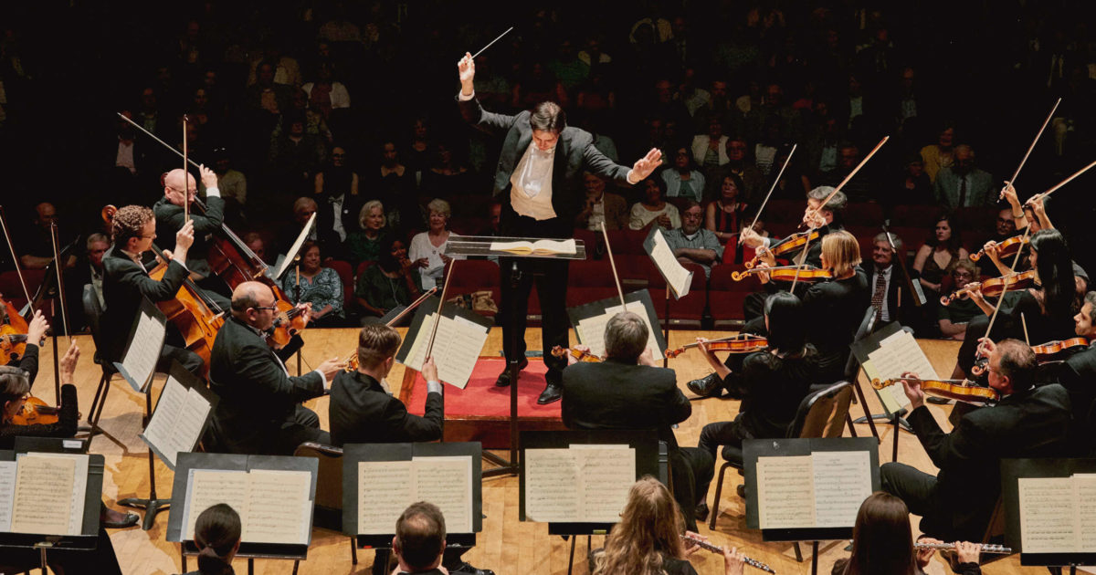

Slide 55
TRANSFORMATIONAL CRO
EDUCATING, ENGAGING & EVANGELISING CRO
MONITORING TEAM PERFORMANCE
RESOURCE MANAGEMENT
HIRING

Slide 56


Slide 57
EXPERIMENTATION OPS™
The management of the operations, processes, platforms and people involved in an experimentation program to ensure predictable, sustainable growth and promotion of a test & learn culture

Slide 58
Project
Management

Slide 59
Program
Management
Project
Management

Slide 60
EXPERIMENTATION OPS
REST OF THE BUSINESS
Program
Management
Project
Management

Slide 61
THE NEED FOR
AN EXPERIMENTATION OPS™ MANAGER
PROACTIVELY manage the operations, processes, platforms and people involved in an experimentation program to ensure predictable, sustainable growth and promotion of a test & learn culture

Slide 62
Not a project manager or CRO manager or specialist
THEIR JOB IS TO
Keep everyone accountable
Spot challenges & bottlenecks
Resource planning & hiring
Maintain and optimise processes
Ensure quality control
Be the liaison between the CRO team, various dept, and c-level

Slide 64
WE’re AT THE CUSP OF
THE NEXT EVOLUTION OF CRO
ANd it CANNOT BE SOLVED WITH
HACKs, shortcuts, Automation OR AI OR ML
WE HAVE TO ENSURE that we REMAIN relevant and an indispensable part of the organisation

Slide 65
CONVERSION OPTIMIZATION IS BUSINESS TRANSFORMATION

Slide 66
GET THE DECK
+
FREE AUDIT & STRATEGY SESSION:
The PATH TO EXPERIMENTATION OPS: transitioning from tactical to transformational
WANT THE DECK & SOME BONUSES?
LINK: http://bit.ly/ddma-manuel

